Slide 1
Transfer Learning in AI & Machine Learning
Concept, types, pretrained models, BERT, fine-tuning, and applications

Slide 2
Contents
01
02
What is Transfer Learning
Types of Transfer Learning
03
04
Pre-Trained Models
BERT-Introduction
05
06
How to Use BERT
Other Pre-Trained Models

Slide 3

What is Transfer Learning?
Transfer learning leverages knowledge gained from one problem (source task) and applies it to a different but related problem (target task) — instead of training from scratch.
Example: A model trained on general images can be adapted for medical image diagnosis.

Slide 4
Formal Definition
Source Domain (Ds) & Task (Ts)
Target Domain (Dt) & Task (Tt)
Objective
Improve performance on Tt using knowledge from Ds and Ts — reducing data and compute needs.
Where the model is originally trained and what it learns to do.
The new environment and task the model is applied to.

Slide 5
Understanding Domain & Task
Source Domain (Ds)
Source Task (Ts)
Original training environment. Example: General English text or ImageNet.
What the model learns. Example: Masked Language Modeling or Image Classification.
Target Domain (Dt)
Target Task (Tt)
New data environment. Example: Financial documents or medical images.
New task to perform. Example: Sentiment analysis or tumor detection.

Slide 6
Types of Transfer Learning
1
Inductive Transfer Learning
2
Transductive Transfer Learning
3
Unsupervised Transfer Learning
Different tasks, labeled data available in the target domain.
Same task but different domains — also called domain adaptation.
No labeled data in either domain; used in clustering or representation learning.

Slide 7

Benefits of Transfer Learning
Saves Time
Less Data Needed
Significantly reduces model training time.
Works effectively even with limited labeled data.
Better Performance
Lower Cost
Improves model accuracy and generalization.
Reduces computational cost and enables rapid AI deployment.

Slide 8
Pretrained Models — Overview
Pretrained models are trained on very large datasets (millions or billions of samples), learning general-purpose features such as edges in images or grammar in text.
BERT
ResNet
VGG
Natural Language Processing (NLP)
Computer Vision tasks
Image classification & detection

Slide 9
Using Pretrained Models
Feature Extraction
Fine-Tuning
Use the pretrained model as a fixed feature extractor by freezing its layers. No retraining occurs.
Retrain part or all of the model to adapt to a new task. Typically yields better performance but requires careful tuning.

Slide 10
Parameters in Pretrained Models
Modern deep learning models contain millions to billions of parameters — including weights, biases,
and embedding layers.
110M
340M
BERT Base Parameters
BERT Large Parameters
Higher parameter count increases model capacity but also computational complexity.

Slide 11
BERT — Introduction
Bidirectional Encoder Representations from Transformers — developed by Google in 2018.
Captures context from both left and right directions in a sentence.
Bidirectional nature significantly improves language understanding.
Based on the Transformer encoder architecture with self-attention.

Slide 12
BERT — Training Tasks & Applications
Masked Language Modeling (MLM)
Next Sentence Prediction (NSP)
Applications
Sentiment analysis, question answering, text classification, and more.
Randomly masks words and trains the model to predict them using surrounding context.
Trains the model to understand relationships between sentence pairs.

Slide 13
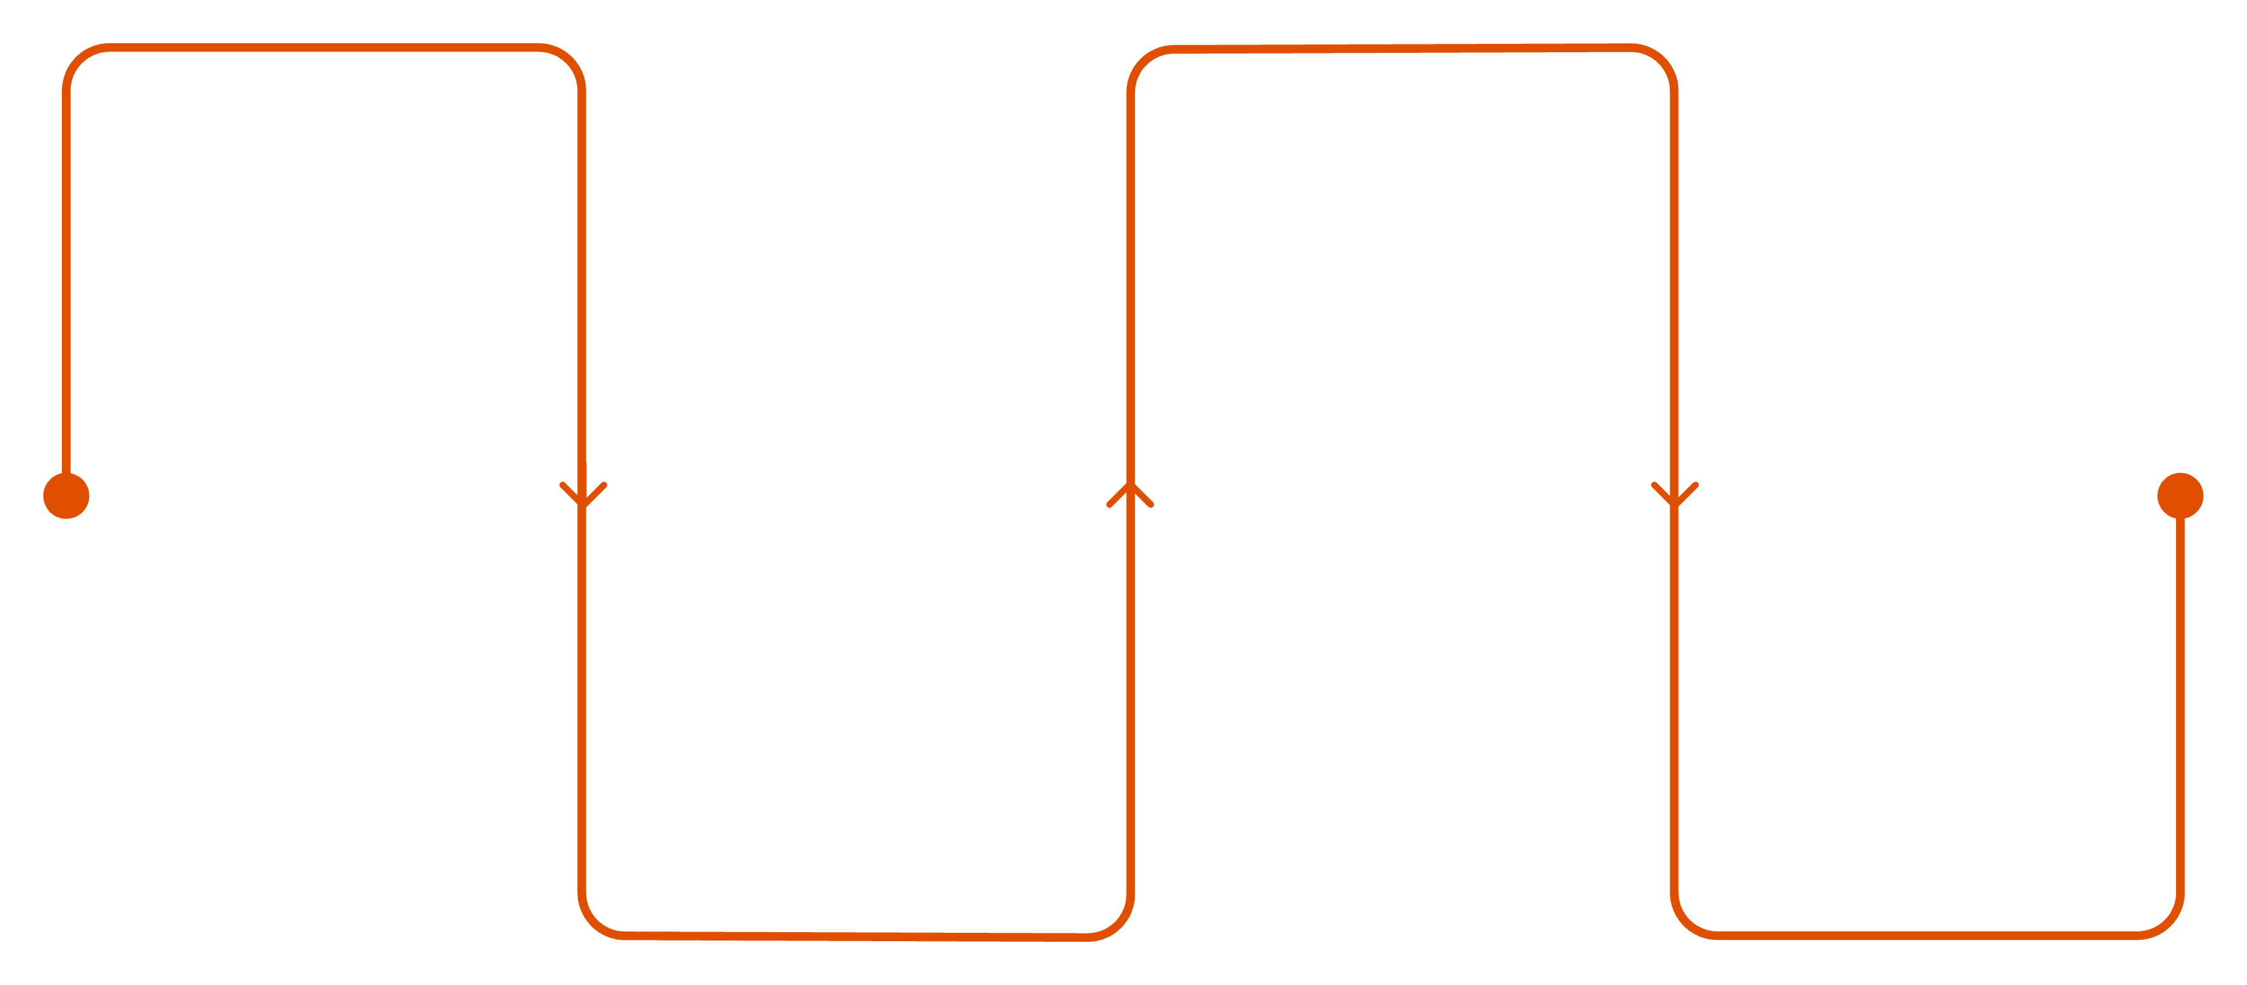
How to Use BERT
Load Model
Embed
Use Hugging Face pretrained BERT
Convert tokens into embeddings
Infer
Tokenize
Pass embeddings through BERT for context
Apply WordPiece tokenizer to text
In high-level libraries like Hugging Face pipeline, tokenization is automatic. For more control, use BertTokenizer explicitly.

Slide 14
How to Fine-Tune BERT
01
02
Add Output Layer
Train on Labeled Data
Attach a task-specific head (e.g., classification layer).
Start from pretrained weights; use small learning rates (2e-5 to 5e-5).
03
04
Optionally Freeze Layers
Run for 2–4 Epochs
Freeze lower layers; train only higher layers to preserve learned knowledge.
Typically sufficient for convergence without overfitting.

Slide 15
Domain-Specific BERT Models
Specialized BERT variants improve performance in real-world domains:
BioBERT
ClinicalBERT
Biomedical literature understanding.
Clinical notes and EHR data.
FinBERT
LegalBERT
Financial sentiment analysis.
Legal document understanding.

Slide 16
Other Pretrained Models: ResNet & VGG
ResNet
VGG
Uses skip connections to enable very deep networks and avoid vanishing gradients. Excellent for image classification and detection.
Simple, consistent architecture with small filters. Widely used as a baseline in computer vision tasks.

Slide 17
Key Takeaways
Transfer learning enables reuse of knowledge across tasks, saving time and data.
Pretrained models are trained on massive datasets with millions of parameters.
Fine-tuning is essential for adapting models to specific tasks.
BERT revolutionized NLP with bidirectional context understanding.
Domain-specific models (BioBERT, FinBERT, etc.) improve accuracy in specialized applications.

